Slide 1
CHEMISTRY OF d- BLOCK ELEMENTS
PART - 1
By
PEDIREDDY K M SUBRAHMANYESWARI DEVI
GUEST FACULTY IN CHEMISTRY
DEPARTMENT OF CHEMISTRY
P.R. GOVT. COLLEGE (A) KAKINADA

Slide 2
Contents:
Introduction
Electronic configuration of d block elements
Variable oxidation States or variable valency

Slide 3
INTRODUCTION

Slide 4
INTRODUCTION
when the differentiating electron enters into the d orbital then the elements are called as d block elements
The d block elements are present in the middle of the periodic table i.e; present between s block and p block
Each d orbital accommodate 10 electrons. The d block elements consists of three complete series each of 10 elements, involving the filling of 3d,4d,5d subshells and they are named as 3d series (Sc to Zn), 4d series (Y to Cd) and 5d series (La to Hg). In addition to this, there is a fourth incomplete series i.e, 6d series.
The general electronic configuration of d block elements is
(X) (n-1) d¹-¹⁰ ns¹or ²
Where X is noble gas

Slide 5
The d block elements are also called as transition elements.
The transition elements are those elements having a partially filled d subshells.
The general properties of transition elements are
They are usually high melting point
They have several oxidation states
The usually form coloured compounds
They have magnetic property
All the transition elements are d block elements are not transition elements.

Slide 6
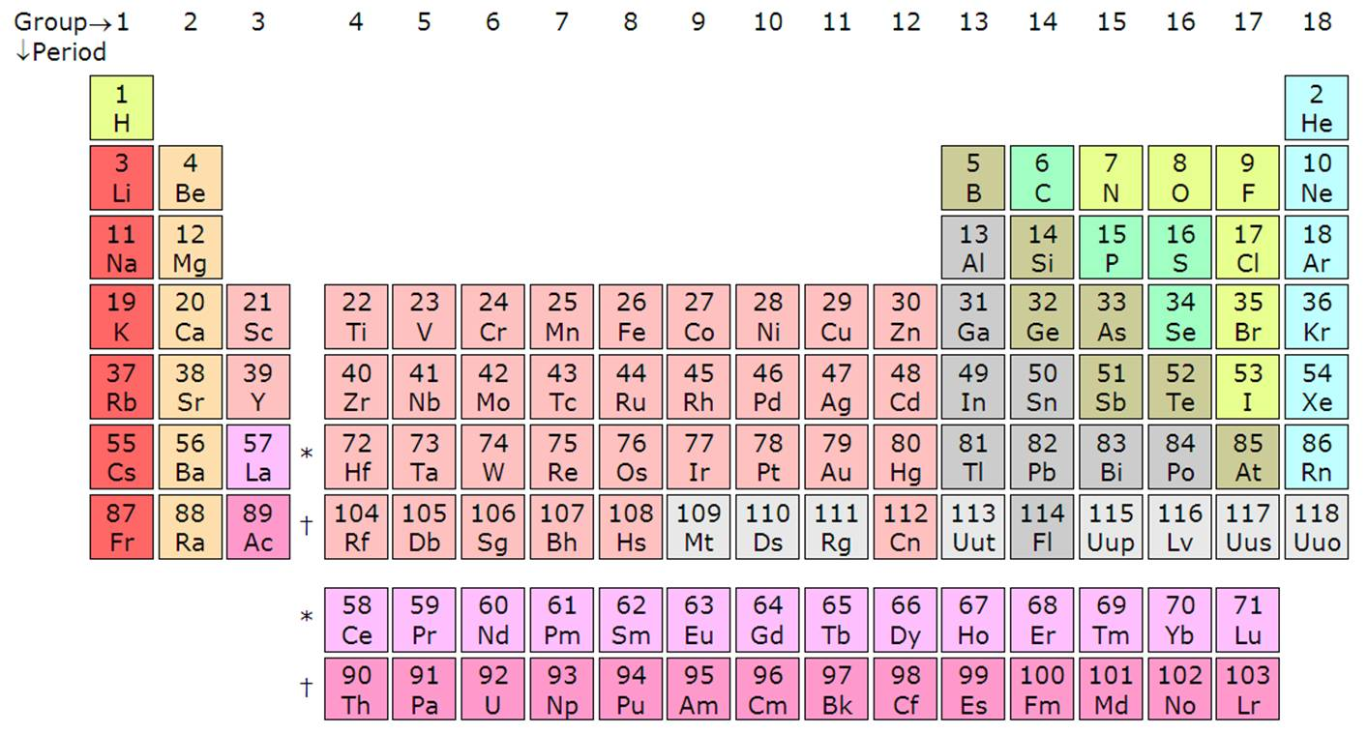

Slide 7
ELECTRONIC CONFIGURATION

Slide 8
Electronic configuration of d block elements:
The electronic configuration of 3d series is as follows
Scandium-Sc- (Ar)3d¹4s²
Titanium- Ti- (Ar)3d²4s²
Vanadium-V-(Ar)3d³4s²
Chromium -Cr-(Ar)3d⁴4s² (or) (Ar)3d⁵4s¹
Manganese-Mn-(Ar)3d⁵4s²
Iron -Fe- (Ar)3d⁶4s²
Cobalt-Co-(Ar)3d⁷4s²
Nickel-Ni-(Ar)3d⁸4s²
Copper-Cu- (Ar)3d⁹4s² (or) (Ar)3d¹⁰4s¹
Zinc-Zn-(Ar)3d¹⁰4s²

Slide 9
From the above it was observed that chromium and copper shows different electronic configuration than other elements because we know that partially and completely filled penultimate shells are more stable.
To get stability in chromium and copper one s electron is goes to the d orbital.
similarly in 4d and 5d series molybdenum,silver,tungsten and gold shows anomalous electronic configuration.
Molybdenum- Mo- (Kr) 4d⁵5s¹
Silver- Ag- (Kr) 4d¹⁰5s¹
Tungsten -W- (Xe) 5d⁵6s¹
Gold-Au- (Xe) 5d¹⁰6s¹

Slide 10
VARIABLE VALENCY

Slide 11
Variable oxidation state or variable valency:
d block elements are metals and are electropositive in nature and having number of electrons these are exist in positive oxidation State due to less energy difference between S orbital and d orbital. they losses both s electron and the electron, exhibit variable oxidation States.
The oxidation states of 3d series elements are as follows
Sc Ti V Cr Mn Fe Co Ni Cu Zn
+2 +2 +2 +1 +2 +2 +2 +2 +1 +2
+3 +3 +3 +2+3 +3 +3 +3 +3 +2
+4 +4 +4 +4 +4 +4 +4
+5 +5 +5 +5 +5
+6 +6 +6
+7

Slide 12
The minimum oxidation state of 3d series is due to s electrons and the maximum oxidation state is due to both s and d electrons.
But this maximum oxidation state is only upto Manganese. After manganese due to pairing of electrons in d orbitals gives extra stability to the element and requires higher energy to remove electrons. Hence after manganese the minimum oxidation state is produced due to unpaired electrons in d orbitals and electrons in s orbital.
The common oxidation state of d block elements is +2.
The maximum oxidation state of 3d series is + 7 i.e, shown by Mn.
Similarly 4d and 5d series shows variable oxidation States. The maximum oxidation state of 4d and 5d series is + 8, shown by Ruthenium(Ru) and Osmium(Os) respectively

Slide 13
THANK YOU

